Slide 1
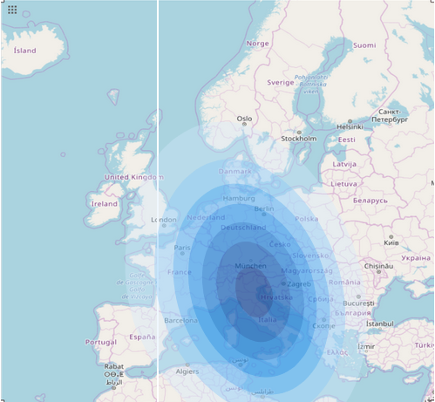
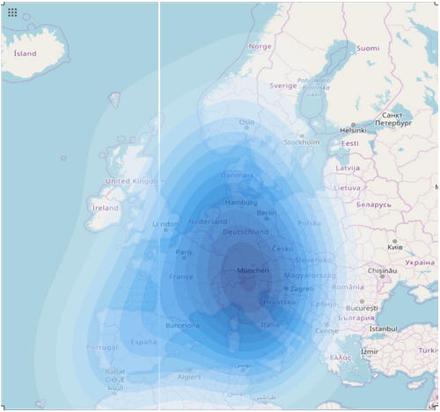
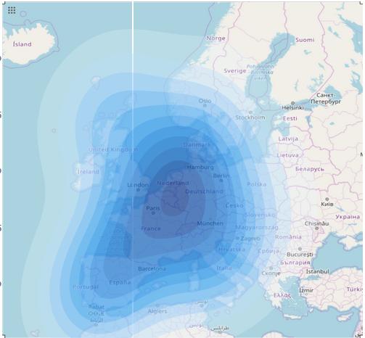
VU Visualisierung 2 (186.833) Spread of Covid-19
Arlind Avdullahi 11813054
Princ Mullatahiri 11846033
Institute of Visual Computing & Human-Centered Technology, TU Wien, Austria

Slide 2
Short Data Summary
Our dataset consists of data of Covid19 spread across world.
Source: Kaggle
It contains number of cases per country from 22th of January until 16th of April.
First case in Europe 24th of January
As of 17th of March all countries in Europe have confirmed cases
Until 16th of April there are 965488 confirmed cases in Europe
Questions we plan to answer:
Spread patterns of Covid-19
How Covid-19 spread trajectory looks like
Notes:
Describe the data you plan to implement
List the questions you plan to answer using visualization
~ 1 minute

Slide 3
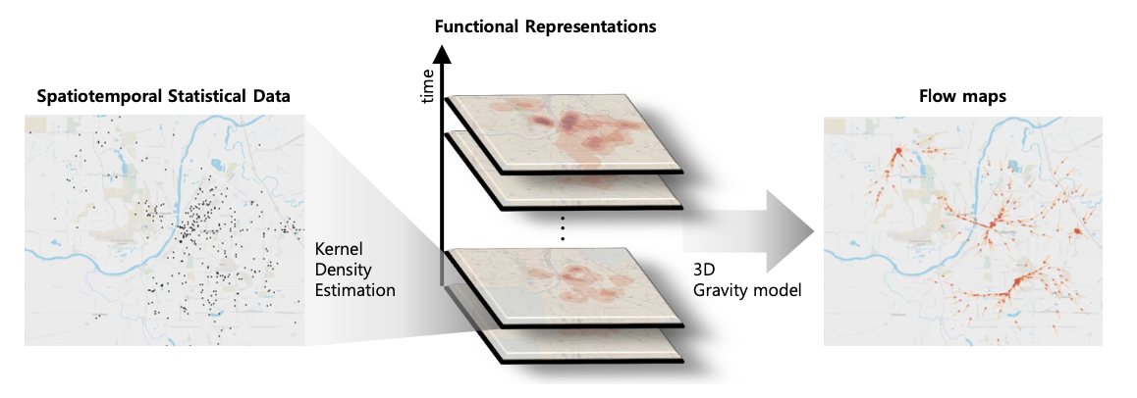
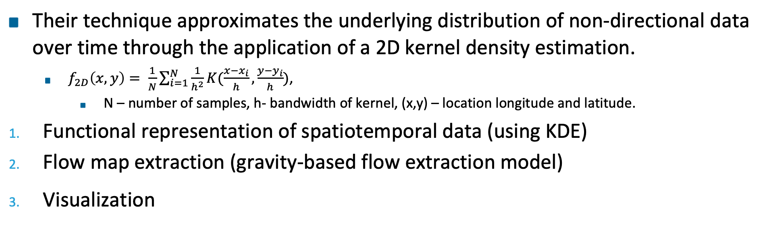
Technique Summary
Their technique approximates the underlying distribution of non-directional data over time through the application of a 2D kernel density estimation.
$f_{2D}\left(x,y\right)= \frac{1}{N}\sum_{i=1}^{N}{\frac{1}{h^{2}}K(\frac{x−x_{i}}{h},\frac{y−y_{i}}{h})}$,
N – number of samples, h- bandwidth of kernel, (x,y) – location longitude and latitude.
Functional representation of spatiotemporal data (using KDE)
Flow map extraction (gravity-based flow extraction model)
Visualization
Fig 1: Visual overview of the system
Notes:
Summarize the algorithms and concepts of the technique (described in a paper or elsewhere) you plan to implement to analyze your data.
If space is available, put some representative image here.
~1 minute

Slide 4
Implementation
We focus our implementation in Europe and ignore the data we have on other countries.
For visualization we use plotly library.
As for 2D KDE we need to reimplement a weighted 2D KDE.
We reimplement scipy.stat.gaussian_kde to weighted kde
For comparison we also use kdeplot from seaborn package
We might need to use Gaussian Kernel instead of Triweight Kernel because there are much more information for 2D Gaussian KDE.
Notes:
You do not need to and often should not stick 100% to the algorithm described in a paper.
If you do not stick closely to a paper, describe what you omit and / or what you will implement additionally.
The design and implementation effort should be proportional to the lab ECTS! Take existing libraries and online examples into account when estimating your effort!
Describe how you plan to implement the work: which visualization or graphics libraries do you plan to use?
Which data preprocessing steps are necessary and which libraries do you plan to use?
If you have any open questions, put them here!
~1 minute

Slide 5
Group Name
Seokyeon Kim, Seongmin Jeong, Insoo Woo, Yun Jang, Ross Maciejewski, David S. Ebert
Data Flow Analysis and Visualization for Spatiotemporal Statistical Data without Trajectory Information
2017
Notes:
This is the last slide that remains visible until the next group comes up.
If you plan to reimplement a paper, put the details here. Otherwise remove this text.
Nothing to say here.

